Slide 1

Front-to-Back Testing
Demo on how to use Cypress and Cucumber to test front-end and back-end code.
Lakshi Villavarayen,
Senior Quality Engineer
Manale Henini,
Software Engineer I

Slide 2
Why test?
Thorough testing is necessary to discover bugs/defects that need to be resolved prior to delivery to client. This ensures the dependability, security, and quality of the software.

Slide 3
CYPRESS

Slide 4
What’s Cypress?
Cypress is a front-end testing tool built for the modern web.
Addresses the key pain points developers and QA engineers face when testing modern applications.
Used typically by developers or QA engineers building web applications using modern JavaScript frameworks.
With Cypress it’s possible to:
Set up tests
Write tests
Run tests
Debug tests

Slide 5
Cypress Features
Cypress consists of a free, open source, locally installed application and a Dashboard Service for recording your tests.
Unlike other front-end testing tools, Cypress is not constrained by the same restrictions
Enables users to write faster, easier and more reliable tests
Cypress can be used to write several different types of tests, including:
End-to-end
Component
API
Integration

Slide 6

Cypress Resources
For more info on how Cypress works, including documentation and tutorials, please visit https://www.cypress.io/

Slide 7
CUCUMBER

Slide 8
First, Behavior-Driven Development
Also known as BDD
An agile software development process
Focuses on expected behavior
Encourages collaboration across whole team
Goal: agree on a how an application should behave based on concrete examples.
Notes:
Before we get into Cucumber, let’s first take a look at Behavior-Driven Development, also known as BDD. BDD is an agile software development process that focuses on the expected behavior of an application. It encourages collaboration among the business and technical roles in a team to come to a shared understanding of how an application should behave in the form of concrete examples.

Slide 9
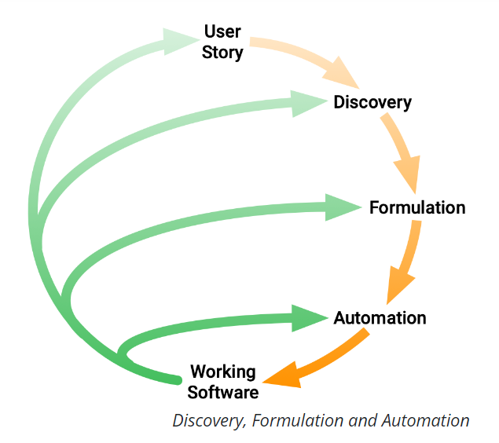



BDD Process
This is a placeholder image. Select the imag, delete it and click on the icon to insert your new image.
Discovery
What it could do: Agree on concrete examples from User Story.
Formulation
What it should do: Document the examples.
Automation
What it actually does: Implement the documented behavior.
Notes:
Essentially, BDD uses the following process:
First, decide on concrete examples of the expected functionality of an application from a given user story.
Next, document those examples in a way that can be automated, such as a test. This is where Cucumber will come into play.
Finally, implement the behaviour described by each documented example, starting with an automated test to guide the development of the code.

Slide 10
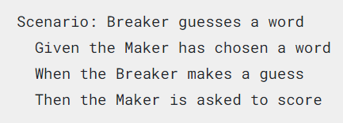
Now, What’s Cucumber?
Cucumber is a tool that supports the BDD process.
Reads plain text specifications and verifies software follows them.
Specifications are made of examples, or scenarios, ex:
Scenarios are made of steps.
Notes:
Now that we know how BDD works, let’s take a look at Cucumber and how this tool supports this process.
Cucumber reads executable specifications written in plain text and validates that the software does what those specifications say. The specifications consists of multiple examples, or scenarios. And each scenario is a list of steps for Cucumber to work through.

Slide 11
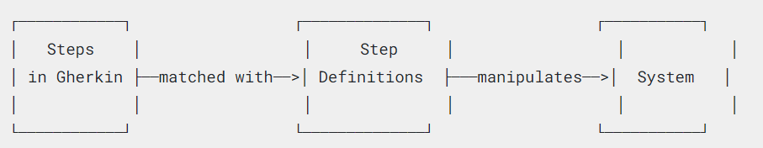
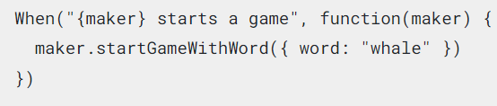
Cucumber Scenarios
Scenarios have 2 parts: Gherkin syntax and Step Definitions
What’s Gherkin?
A set of grammar rules to give plain text structure
Gherkin documents are stored in .feature text files
What are Step Definitions?
Connect Gherkin steps to programming code
Can be written in many programming languages. JavaScript example:
Notes:
There are 2 parts to creating a scenario in Cucumber. The first part is the plain text steps. These are written in Gherkin, which is a set of grammar rules that gives the plain text a structure for Cucumber to understand The plain text is stored in .feature files. The next part of a scenario is the Step Definitions that connect the Gherkin steps to programming code. Step Definitions can be written in many programming languages and carries out the action that should be performed by the step.

Slide 12
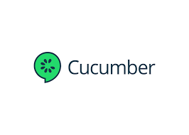

Cucumber Resources
For more info on how Cucumber works, including documentation and tutorials, please visit https://cucumber.io/
To access the complete code for the cucumber tutorial and these slides please visit https://github.com/mhenini/CucumberDemo Or scan

Slide 13


